Slide 1
Empirical investigation

Slide 2
Contents
    Software engineering investigation
    ◆ Investigation principles
    Four principles of Investigation
    1. Choosing an investigative technique
    2. Stating the hypothesis
    3. Maintaining control over variables
    4. Making your investigation meaningful
    Planning Formal Experiments
     Formal experiments: Procedures
    ◆ Formal experiments: Principles
    ◆ Formal experiments: Types
    ◆ Formal experiments: Selection
    Planning case studies

Slide 3
Empirical SE
Fill the gap between research and practice by:
■ Developing methods for studying SE practice
■ Building a body of knowledge of SE practice
■ Validating research before deployment in industrial settings

Slide 4
SE Investigation
What is software engineering investigation?
 Applying “scientific” principles and techniques to investigate properties of software and software related tools and techniques.
Why talking about software engineering
investigation?
Because the standard of empirical software
engineering research is quite poor.

Slide 5
SE Investigation. why?
To improve (process and/or product)
To evaluate (process and/or product)
To prove a theory or hypothesis
To disprove a theory or hypothesis
To understand (a scenario, a situation)
To compare (entities, properties, etc.)

Slide 6
SE Investigation. what?
Person’s performance
Tool’s performance
Person’s perceptions
Tool’s usability
Document’s understandability
Program’s complexity, etc.

Slide 7
SE Investigation. where & when?
■ In the field
■ In the lab
■ In the classroom
Anytime depending on what questions you are asking.

Slide 8
SE Investigation. how?
Hypothesis/question generation
Data collection
Data evaluation
Data interpretation
■ Feed back into iterative process

Slide 9
SE have many question to answer
Test team –which technique is best for finding faults in code
Maintainer-need best tool to support configuration management.
Project manager determine best programmer
Designer looks for best model for reliability
To answer these and other questions, we often rely on the advice and experience of others, which is not always based on careful and scientific research.

Slide 10
As a software practitioner, it is important to make decisions or assessments in an objective and scientific way.
We discussed in previous chapters that measurement plays a crucial role in assessing scientifically our current situation and in determining the magnitude of change when we manipulate our environment.
This chapter outline the assessment techniques available and describe which to use in a given situation.
As a software practitioner, it is important to make decisions or assessments in an objective and scientific way.
We discussed in previous chapters that measurement plays a crucial role in assessing scientifically our current situation and in determining the magnitude of change when we manipulate our environment.
This chapter outline the assessment techniques available and describe which to use in a given situation.

Slide 11
SE Investigation: Characteristics
■ Data sources come from industrial settings
■ This may include people, program code, etc.
Usually
■ Surveys
■ Case-studies (→ hypothesis generation)
■ Experiments (→ hypothesis testing)
10

Slide 12
Where Data Come From?
■ First Degree Contact
■ Direct access to participants
■ Example:
■ Brainstorming
■ Interviews
■ Questionnaires
■ System illustration
■ Work diaries
■ Think-aloud protocols
■ Participant observation
12

Slide 13
Where Data Come From?
■ Second Degree Contact
■ Access to work environment during work time,
but not necessarily participants
■ Example:
■ Instrumenting systems
■ Real time monitoring
13

Slide 14
Where Data Come From?
■ Third Degree Contact
■ Access to work artifacts, such as source code,
documentation
■ Example:
■ Problem report analysis
■ Documentation analysis
■ Analysis of tool logs
■ Off-line monitoring
14

Slide 15
Contents
    Software engineering investigation
    ◆ Investigation principles
    Four principles of Investigation
    1. Choosing an investigative technique
    2. Stating the hypothesis
    3. Maintaining control over variables
    4. Making your investigation meaningful
    Planning Formal Experiments
     Formal experiments: Procedures
    ◆ Formal experiments: Principles
    ◆ Formal experiments: Types
    ◆ Formal experiments: Selection
    Planning case studies

Slide 16
4.1.Four principles of investigation
Manager proposed to use new tool , technique or method.
You have decided to investigate the tool , technique or method in scientific way.
Your scientific investigation is likely to involve a survey, a case study or a formal experiment.

Slide 17
Cont…
There are 4 main principles of investigation:
1. Selecting investigation technique: conducting surveys, case studies, formal experiments
2. Stating the hypothesis: What should be investigated?
3. Maintaining control over variables: dependent and independent variables
4. Making meaningful investigation: verification of theories, evaluating accuracy of models, validating measurement results.

Slide 18
4.1.1 Choosing an Investigation Technique
Investigation in the form of
  When performing Survey , no control over the situation at hand. That is because it is a retrospective study, you can record a situation and compare with the similar ones. But you cannot manipulate variables as you do with case studies and experiments. (research in the large)

Slide 19
(Contd)
Case studies and formal experiments are usually not retrospective. You decide on what you investigate in advance and then plan how to capture data to support your investigation.
A case study is a research technique where you identify key factors that may affect the outcomes of an activity and then document the activity: its inputs, constraints, resources and outputs. (research in the typical)

Slide 20
(Contd)
A formal experiment is a rigorous, controlled investigation of an activity, where key factors are identified and manipulated to document their effects on the outcome. (research in the small)

Slide 21
(Contd)
First step is your investigation is retrospective or not. If already occurred you must perform survey or case study.
Yet to occur-choose between case study or formal experiment.
The level of control – if high level of control over the variables – prefer formal experiments.

Slide 22
4.1.2.Stating the hypothesis
The first step is deciding what to investigate.
The goal for the research can be expressed as a hypothesis in quantifiable terms that is to be tested.
The test result (the collected data) will confirm or refute the hypothesis.
Example:
Can Software Reliability Engineering (SRE) help us to achieve an overall improvements in software development practice in our company?

Slide 23
Example1
Experiment: research in the small
You have heard about software reliability engineering (SRE) and its advantages and may want to investigate whether to use SRE in your company. You may design a controlled (dummy)apply the SRE to it. You project and technique it. You may want to experiment with the various phases of application (defining operational profile, developing test-cases and decision upon adequacy of test run) and document the results investigation for further investigation.

Slide 24
Example 2
Case Study research in the typical
You may have used software reliability engineering (SRE) for the first time in a project. In your company, after the project is completed, you may perform a case-study to capture the effort involved (budget, personnel), the number of failures investigated, and the project duration.

Slide 25
Example 3
Survey: investigate in large
After you have used SRE in many projects in your company, you may conduct a survey to capture the effort involved (budget, personnel),the number of failures investigated, and the project duration for all the projects. Then, you may compare these figures with those from the projects using conventional software test technique to see if SRE could lead to an overall improvements in practice .

Slide 26
4.1.3.Maintaining control over Variables
You must decide what variables may affect truth of a hypothesis?
How do they affect it?
Variable:
  Independent (values are set by the experiment or initial conditions).
  Dependent (values are affected by change of other variables).
Example: Effect of “programming language” on the “quality” of resulting code.
Programming language is an independent and quality is a dependent variable.

Slide 27
Cont…
Suppose you want to determine to change the programming language can affect the productivity of your project.
Currently use FORTON(control Language) an effect of change to Ada .(experimental One).
We can see the difference in productivity.

Slide 28
4.1.4.Making your Investigation Meaningful
Key motivator for using a formal experiment rather than a case study or survey is that result of an experiment are usually more generalizable. That is if you use a survey or case study to understand what is happening in a certain organization, the results apply only to that organization.
But in formal experiment result are generally applicable to wider community and come across organization.
In the examples below , we will see how each of these investigations can help to answer a variety of questions.

Slide 29
4.1.4.1.Confirming Theories an “Conventional Wisdom”
Many techniques and methods are used in SE because “conventional wisdom” suggest that they are best approach.
Many corporate , national & international standards are based on conventional wisdom.
Eg:- Many organizations use standard limits on structural measures.
There is very little quantitative evidence to support claims of effectiveness of these and many other standards, methods and tools.
Case study and survey can be used in single organization.
Formal experiments investigate the situations in which the claims are true generally and it provides a context in which certain tools, standards and methods are recommended for use.

Slide 30
4.1.4.2.Exploring Relationships
Software practitioner are interested in the relationship among various attributes of resources and software products.
Eg: How does the requirements quality affect the productivity of the designers?
The relationship can be suggested by a case study or survey.
For instance, a survey of completed projects may reveal that software written in Ada has fewer faults than software written in other languages.

Slide 31
Contd..
Clearly, understanding and verifying these relationships is crucial to the success of any project.
Each relationship can be expressed as a hypothesis, and a formal experiment can be designed to test the degree to which the relationship holds.

Slide 32
4.1.4.3.Evaluating the accuracy of models
Models are often used to predict the outcome of an activity or to guide the use of method or tools.
Size model-how large the code.
cost model-predict how much for maintenance and development .
Model is difficult in experiment or case study because prediction often affect the output.

Slide 33
4.1.4.4.Validating measures
Preserve the relationship means that the measure must be objective and subjective at the same time:
  Objective-it does not vary with the measurer
  Subjective-reflects the intuition of the measurer.
  A measure is said to be “valid” if it reflects the characteristics of an attribute under differing conditions.
  Thus code Module X has complexity measure C. The code is augmented with new code and the resulting module X’ is now perceived to be much more difficult to understand.
  If the complexity measure is valid , then the complexity measure C’ of X’ should be larger than C.
  In general a study can be conducted to test whether a given measure appropriately reflects changes in the attribute it is supposed to capture.

Slide 34
Contents
    Software engineering investigation
    ◆ Investigation principles
    Four principles of Investigation
    1. Choosing an investigative technique
    2. Stating the hypothesis
    3. Maintaining control over variables
    4. Making your investigation meaningful
    Planning Formal Experiments
     Formal experiments: Procedures
    ◆ Formal experiments: Principles
    ◆ Formal experiments: Types
    ◆ Formal experiments: Selection
    Planning case studies

Slide 35
4.2.Planning Formal Experiments
Formal experiment is best investigation technique.
We require a great deal of and planning to provide meaningful useful results.

Slide 36
4.2.1.Procedures for Performing Experiments
Several steps:
  Conception
  Design
  Preparation
  Execution
  Analysis
  Dissemination and decision making

Slide 37
4.2.1.1.Conception
Define your goal of your experiment
State clearly and precisely the objective of your study.
Make comparison for methods or tools.
Choose your objective and it can be evaluated at the end of the experiment.
State a question you want to answer.

Slide 38
4.2.1.2.Design
Translate the objective into formal hypothesis
  Null Hypothesis-no difference in two code quality between code produce using cleanroom and code produced using our current process.
  Experimental Hypothesis-quality of code produced using cleanroom is higher than the quality of code produced using current process.

Slide 39
Cont…
Eg: doctor, Card
Treatment
  The new method or tool you wish to evaluate (compared with an existing or different method or tools )is called treatment
Trial
  An individual test of this sort is sometimes called a trial
Experiment
  Defined as set of trial(more than one treatment)

Slide 40
Cont…
Experimental object or unit-object(module or program) to which the treatment(tools can be used on object) is being applied.
Experimental subject-who is applying the treatment those person called as experimental subject.
Control object – object not using or being affected by the treatment.
Response variable - that are expected to change or differ as a result of applying the treatment .

Slide 41
4.2.1.3.Preparation
Involves reading the subjects for application of the treatment
eg:- preparation for your experiment may involve purchasing tools , training staff, configuring hardware in a certain way.
Instruction written out or recorded properly

Slide 42
4.2.1.4.Execution
Finally experiment can be executed . Steps laid out plan, measuring attribute prescribed by the plan, apply the treatment to the experimental objects.

Slide 43
4.2.1.5.Analysis
Analysis of two parts
  1.review all the measurement taken to make sure that they are valid and useful.(Analyse all)
  2.analyze the set of data according to the statistical principles.(it gives you answer to the original question)
  At end you get conclusion about how the different characteristic you examined affected the outcome.

Slide 44
4.2.1.6.Dissemination(giving out) and Decision Making
Important to document your conclusion that allow your colleagues to duplicate your experiment and confirm your conclusion in a similar setting
At the end all document contain objective, hypothesis, experimental subject and objects, response and state variable, treatments and the resulting data.

Slide 45
4.2.1.6.Dissemination(giving out) and Decision Making
Experimental results
  You may use to support decisions about how you will develop or maintain projects in future.
  Others may use your results to suggest changes to their development environment.
  It can be used to perform similar experiments with variation in subject and state variables.

Slide 46
Contents
    Software engineering investigation
    ◆ Investigation principles
    Four principles of Investigation
    1. Choosing an investigative technique
    2. Stating the hypothesis
    3. Maintaining control over variables
    4. Making your investigation meaningful
    Planning Formal Experiments
     Formal experiments: Procedures
    ◆ Formal experiments: Principles
    ◆ Formal experiments: Types
    ◆ Formal experiments: Selection
    Planning case studies

Slide 47
4.2.2.Principles of Experimental Design
Examine the principles that you consider in design
Each principles addresses the need for simplicity and for maximizing the information.
Simple design are easier to analyze.
Make experimental practical, minimizing the use of time , money, personnel , etc..

Slide 48
Cont…
Two important concept.
  1.Experimental unit
    Experimental object to which a single treatment is applied.
    Eg-collection of program is given to programmer , to identify the known faults.
    Programmer take more time today to find the set of faults than he or she took yesterday.

Slide 49
Cont…
  2.Experimental error
    Describes the failure of two identically treated experimental unites to yield identical results.(today program with equivalent seeded faults in yesterday program)
The aim of a good experimental design is to control for as many variables as possible, both to minimize variability among participants and to minimize the effects of irrelevant variables.
We would like to eliminate the experimental error, complete elimination is not always possible.
To minimize the error, three major principles are:
  Replication
  Randomization
  Local control

Slide 50
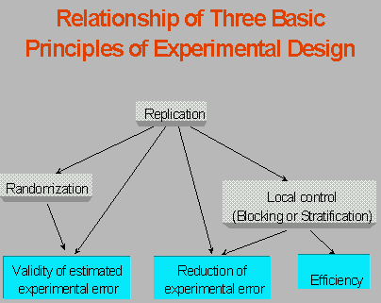

Slide 51
4.2.2.1.Replication
Repetition of the basic experiment
Repeating the experiment under identical condition , rather than repeating measurement on the same experimental unit.
  1.it provide an estimate of experimental error
  2.It enable us to estimate the mean effect of any experimental factor.

Slide 52
Contd..
It is important to ensure that replication does not introduce the confounding of effects.
Two or more variables are said to be confounded if it is impossible to separate their effects when the subsequent analysis is performed.

Slide 53
Example
Comparing new tool with your existing tool.
You set up an experiment where programmer A uses the new tool in your development environment, while programmer B uses the existing tool.
When you compare measures of quality in the resulting code, you cannot say how much of the difference is due to the tools because you have not accounted for the difference in the skills of the programmers.
That is the effects of the tools (one variable) and the programmers skills (another variable) are confounded.
This confounding is introduced with the replication when the repetition of the experiment does not control for other variables.

Slide 54
4.2.2.1.Replication
  Two reason why we need replication
  1) If a treatment appears only once in an experiment , there is no replication of the treatment and the error associated with the estimate of the treatment effect cannot be estimated. Experimental error occurs when two or more identically treated experimental units fail to yield identical results. Thus, replication of treatments provides an estimate of experimental error;
  2) Replication also enables us to obtain a more precise estimate of the main effect of any factor since the standard deviation of the mean = , where represents the true experimental error and n the number of replications.

Slide 55
4.2.2.2.Randomization
It is the random assignment of subjects to group or treatment to experimental units , so that we can assume independence of result.
Eg:-test team is trained with test technique ‘X’ and ask to test the modules.
Then ‘Y’ is trained.
Suppose 30 programmer is trained to perform both testing technique . Randomly assign 15 programmer to use Technique ‘X’ and remaining ‘Y’ on the same program.

Slide 56
Cont…
Related within the subject design
  Use same subject in all experiments conditions(15 programmer to use X technique)
Unrelated between subject design
  Use different subjects in different experimental conditions(use different techniques)

Slide 57
4.2.2.3.Local Control
Local control is the aspect of the experimental design that reflects how much control you have over the placement of subjects in experimental units.
Where as replication and randomization ensure a valid test of significance, local control makes the design more efficient by reducing the magnitude of the experimental error.
It characteristics of the design
  1. Blocking
  2. Balancing

Slide 58
1. Blocking
  allocating experimental units to blocks or groups so the units within a block are relatively homogeneous. The blocks are designed so that the experimental design captures the anticipated variation in the blocks by grouping like varieties, so that the variation does not contribute to the experimental error.
Eg-comparative effects of 3 design techniques on the quality.
Experiment involves teaching the techniques to 12 developers an measure the number of errors in KLOC.
12 developer graduated from 3 university
Developer trained in different way depends on university.
To eliminate this 3blocks .1block from university ‘x’ 2block from university ‘y’ 3block from university ‘z’.
Then treatment assigned random to the developers from each block.1block has 6 developer so 2 assigned to design method A, two to B , and two to C

Slide 59
Cont…
2.Balancing
  It is the blocking and assigning of treatments
  so that an equal number of subjects(techniques) is assigned to each treatment. Balancing is desirable because it simplifies the statistical analysis.

Slide 60
Contents
    Software engineering investigation
    ◆ Investigation principles
    Four principles of Investigation
    1. Choosing an investigative technique
    2. Stating the hypothesis
    3. Maintaining control over variables
    4. Making your investigation meaningful
    Planning Formal Experiments
     Formal experiments: Procedures
    ◆ Formal experiments: Principles
    ◆ Formal experiments: Types
    ◆ Formal experiments: Selection
    Planning case studies

Slide 61
4.2.3.Types of experimental designs
Its useful to know and understand the several types of design that used in SE research.
Measurement scale of the variable.
  Nominal scale-divide data into categories and analyzed by statistical test(Sign test).
  Ordinal scale- permit rank ordering and can be investigate with more powerful test(Wilcoxon)
  Interval scale-analysis the variance(parametric test)

Slide 62
Factor and Levels
Independent variable is called factor.
Various values or classification for each factor are called the levels.
Expressing the design in terms of factors called factorial design.
Tells how many treatment combinations are required
How the level of one factor combined with level of another factor to form the treatment combination?
The engineering research are based on two simple relations between factors: Crossing and Nesting

Slide 63
4.2.3.1.Crossing
Crossing (each level of each factor appears with each level of the other factor) This relationship is denoted by A x B.
That is your experiment must include treatments for each possible combinations of language and experience.
a_{i} represents the levels of each Factor A and b_{j} the level of each Factor B.
Design A x B x C means that all combinations of all the levels occur.
Eg- Two factor-experience and language(your experiment must include treatments for each possible combination of language and experience).

Slide 64
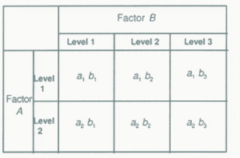
Crossed design with n level of the first factor and m levels of the second factor will have nm cells with cell representing a particular situation.

Slide 65
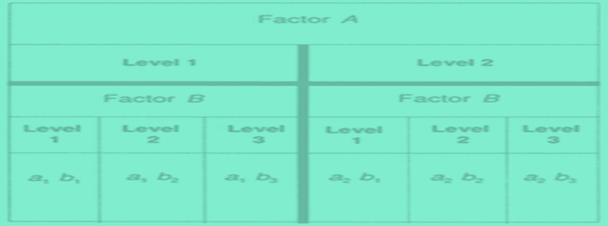
4.2.3.2.Nesting
Nesting (level of Factor A occurs entirely in conjunction with one level of factor B)
This relationship is depicted as B(A),where B is nested factor and A is the nest factor.
Proper nested or crossed design may reduce the number of cases to be tested.

Slide 66
Nesting - Example
Factor A be the language and B be the year of experience with a particular language.
Suppose A has two levels , COBOL and Pascal, and B separates the programmers into those with less than two years of experience with the language and those who have more.

Slide 67
Formal Experiments: Types
■ Advantages of factorial design
■ Resources can be used more efficiently
■ Coverage (completeness) of the target variables’ range of
variation
■ Implicit replication
■ Disadvantages of factorial design
■ Higher costs of preparation, administration and analysis
■ Number of combinations will grow rapidly
■ Some of the combinations may be worthless
34

Slide 68
Contents
    Software engineering investigation
    ◆ Investigation principles
    Four principles of Investigation
    1. Choosing an investigative technique
    2. Stating the hypothesis
    3. Maintaining control over variables
    4. Making your investigation meaningful
    Planning Formal Experiments
     Formal experiments: Procedures
    ◆ Formal experiments: Principles
    ◆ Formal experiments: Types
    ◆ Formal experiments: Selection
    Planning case studies

Slide 69
4.2.4.Selecting an experimental design
This section describes about how to decide which design is right for your situation.
Ultimate choice depends on two things:
  the goal of your investigation
  availability of resources.

Slide 70
4.2.4.1.Choosing the number of factors
Many experiment involve only one variable or factor. Many levels of variable that are compared then experiment may be quit complex.
Eg-two factor module size and reuse.
Each factor has two levels
  Module size-small and large
  Reuse- present or absent
  No interaction between two factor

Slide 71
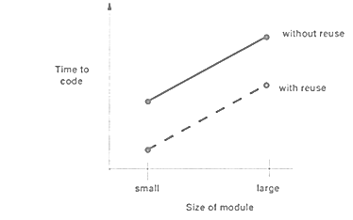


Slide 72
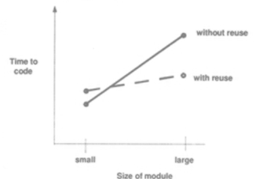
Indeed interaction between the variable since the lines are not parallel

Slide 73
4.2.4.1.Factors versus blocks
  To determine which approach is best, consider the hypothesis.
  If we are interested in whether design A is better than design B, then experience should be treated as a blocking variable.
  However if we are interested in whether the results of using design methods A and B are influenced by staff experience then experience should be treated as a factor.
  If we are interested in interactions then blocking will suffice; if interactions are important multiple factors are needed.
  Example:
  Block - Match staff with similar experience
  Factor - Assign staff randomly to the different treatments

Slide 74
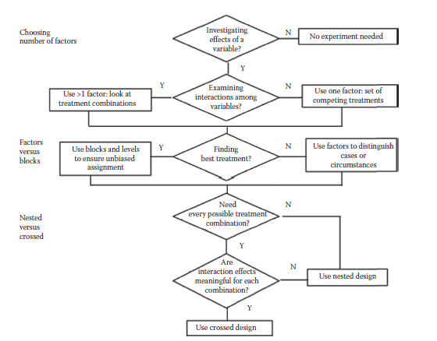
4.2.4.2.Choosing Between Nested And Crossed Designs

Slide 75
Nested design is useful for investigation one factor with two or more conditions
Crossed design useful for looking at two factors, each with two or more conditions.

Slide 76
4.2.4.3.Fixed and Random Effects
Fixed effects model has factor levels or blocks that are controlled.
The purpose of an experiment is to compare the effects of three specific dosages of a drug on the response. "Dosage" is the factor; the three specific dosages in the experiment are the levels; there is no intent to say anything about other dosages.
Random Effects Model has factor level or blocks that are random samples from a population of values.
Two surgical procedures are being compared. Patients are randomized to treatment. Five different surgical teams are used. To prevent possible confounding of treatment and surgical team, each team is trained in both procedures, and each team performs equal numbers of surgery of each of the two types. Since the purpose of the experiment is to compare the procedures, the intent is to generalize to other surgical teams. Thus surgical team should be considered as a random factor, not a fixed factor.

Slide 77
4.2.4.3.Fixed and Random Effects
Factor allow us to have complete control over them.
Eg-we can able to control what language is used to develop a system, other factor are not easy to control(staff experience)

Slide 78
4.2.4.3.Matched or same subject design
Same programmer to use tool A in one situation and tool B in another situation the same tools

Slide 79
4.2.4.Repeated Measurements
Repeating a measurement can be helpful in validating it, by assessing the error associated with measurement process.
Eg-experiment involve one product and three developers . Each developers asked to calculate number of the function point , at three different times like after completion of specification , design and implementation

Slide 80
Contents
    Software engineering investigation
    ◆ Investigation principles
    Four principles of Investigation
    1. Choosing an investigative technique
    2. Stating the hypothesis
    3. Maintaining control over variables
    4. Making your investigation meaningful
    Planning Formal Experiments
     Formal experiments: Procedures
    ◆ Formal experiments: Principles
    ◆ Formal experiments: Types
    ◆ Formal experiments: Selection
    Planning case studies

Slide 81
4.3.Planning Case Studies
Every case study requires
  Conception
  Design
  Preparation
  Execution
  Analysis
  Dissemination an decision making

Slide 82
Cont…
It usually compares one situation with another, the result of using one tool or method with the results of using another.
To avoid this bias you make sure that you are testing the relationship you hypothesize, you can organize your study in one of three ways:
  Sister project
  Baseline
  Random selection

Slide 83
4.3.1 Sister projects
Suppose our organization is interested in modifying the way it does code inspections.
Let us say we decide to perform a case study to assess the effects of using a new inspection technique.
To do such a study, we select 2 projects, called sister projects, each of which is typical of the organization and has similar values for the state variables that we plan to measure.
For example, projects may be similar in terms of application domain, implementation language, specification technique and design method.
Then we perform inspections in the current way on the first project and the new way on the second project.
This situation allows us to attribute any differences in result to the difference in inspection technique.

Slide 84
4.3.2 Baselines
If we are unable to find 2 projects similar enough to be sister project, we can compare our new inspection technique with a general baseline.
Here a company gathers data from its various projects, regardless of how different one project is from another.
The data here can include descriptive measures, such as product size, effort expended, number of faults discovered, etc.
Then we can calculate the measures of central tendency and dispersion on the data in the database, so we have some idea of the “average” situation that is typical in our company.
Then our case study involves completing a project using the new inspection technique, and then comparing the results with the baseline.

Slide 85
4.3.3 Random selection
Sometimes, it is possible to partition a single project into parts, where one part uses the new technique while the other does not.
Here we can randomly assign the code components to either the old inspection technique or the new.
This technique is good for situations where the method being studied can take on a variety of values.
For example, we may want to find whether preparation time affects the effectiveness of the inspections.
We can record the preparation time as well as component size and faults discovered.
Then we can investigate whether increased preparation time results in a higher detection rate.

